Slide 1
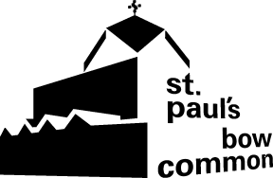
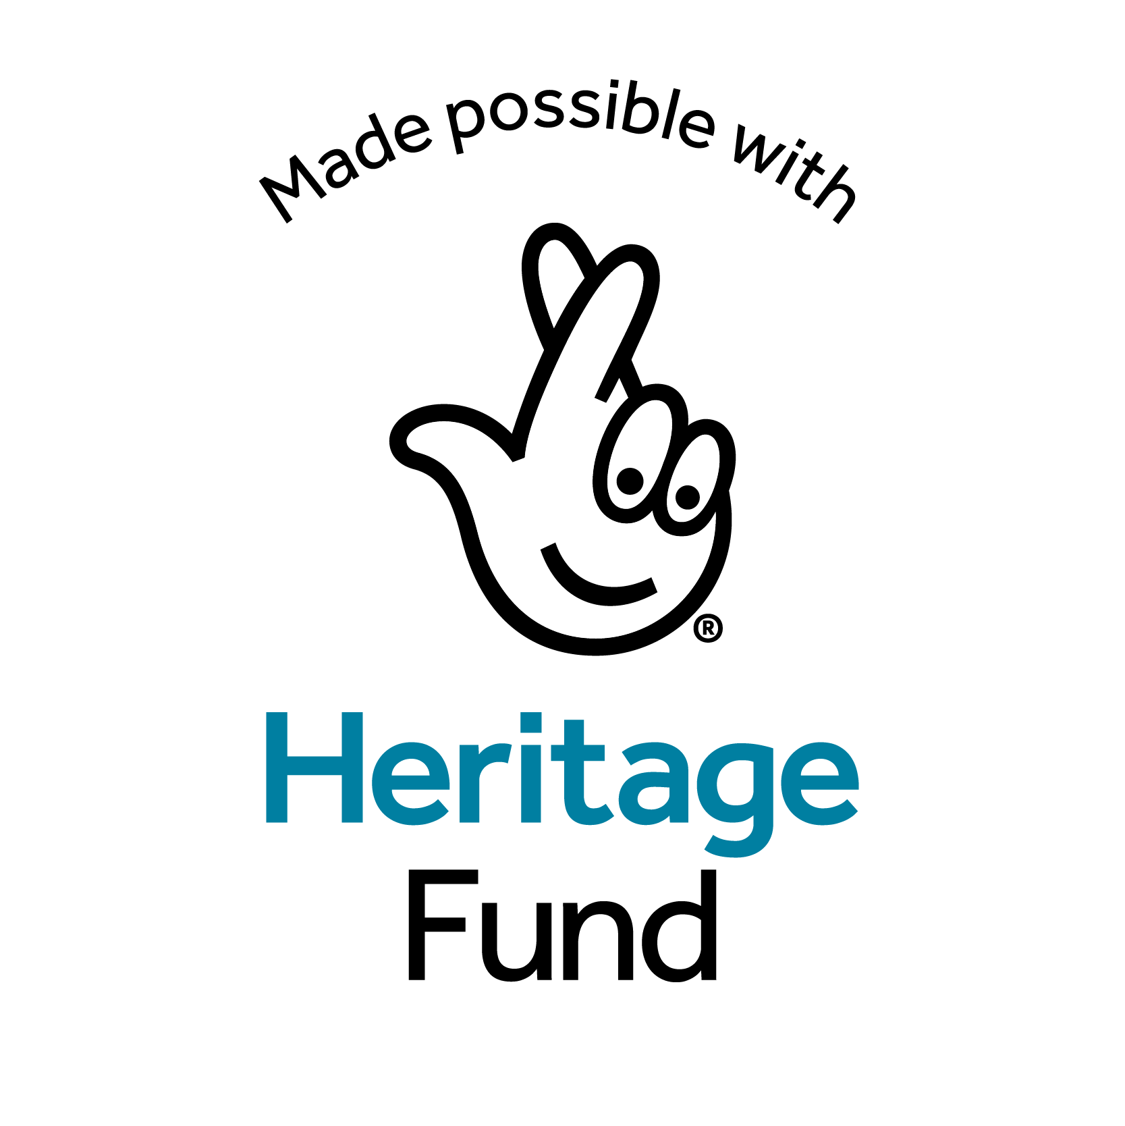
St Paul’s Bow Common
Art Activity Sheets – class resource

Slide 2
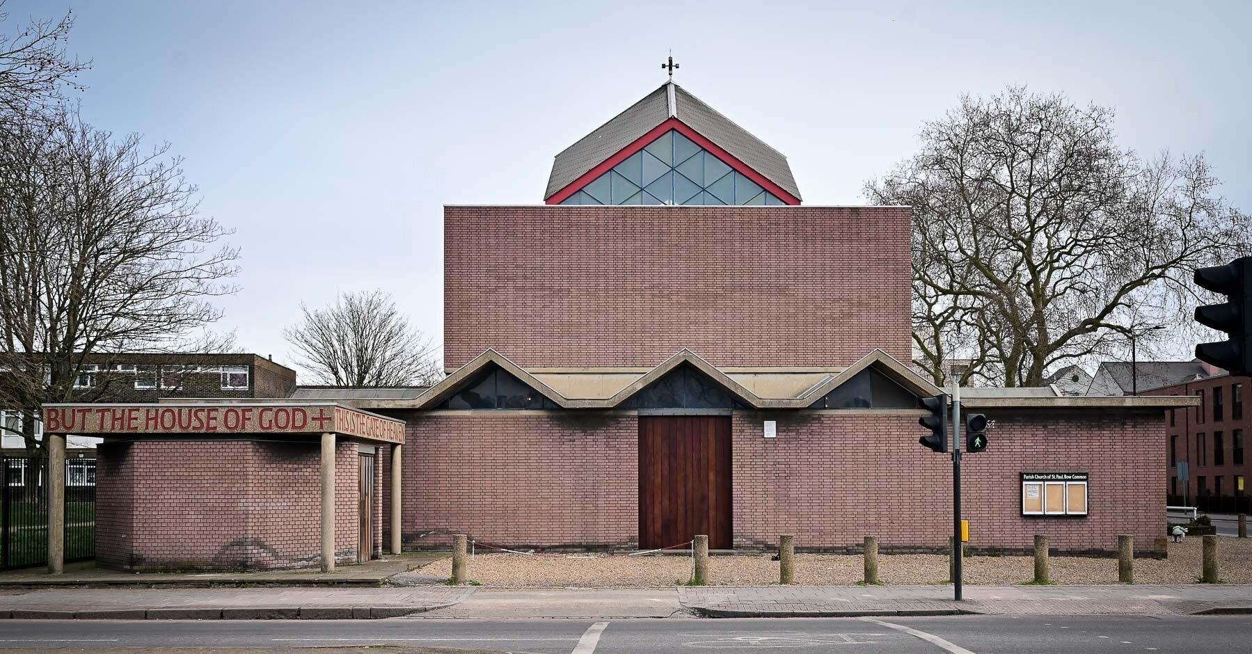
Notes:
This is St Paul’s Bow Common. It’s a church built in a modern design and is considered a very special building because of its unique shape and layout.

Slide 3
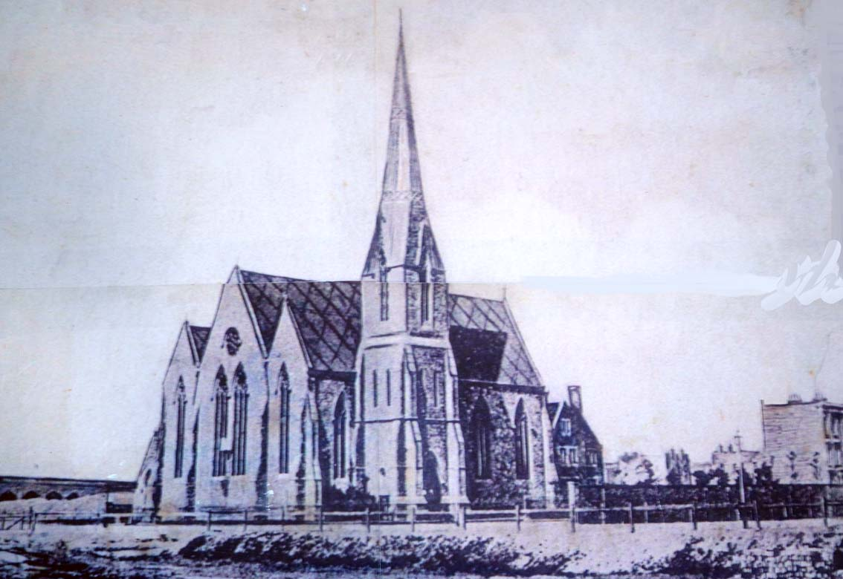
Notes:
However, this was not the first St Paul’s. The first church in Bow Common was built in 1858. It looks like the type of church we usually recognise.

Slide 4
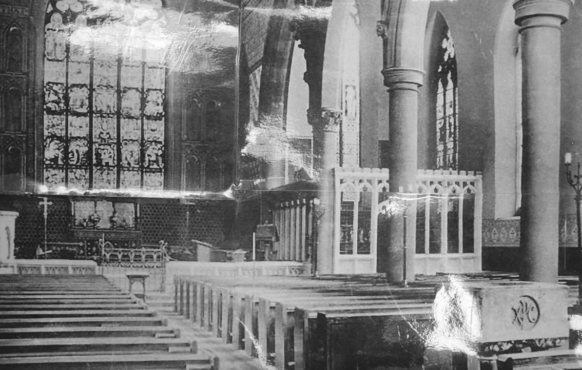
Notes:
This old photograph shows that the inside of the church was quite decorated, with [architectural] features like arches and pillars, carved stone work and stained glass windows.

Slide 5
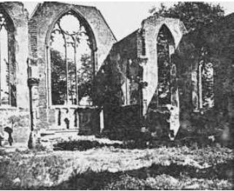
Notes:
The church was destroyed when a fire bomb landed on it during World War II. Older people still remember the bombing raids on East London during the war.
BETTER IMAGE AVAILABLE?

Slide 6
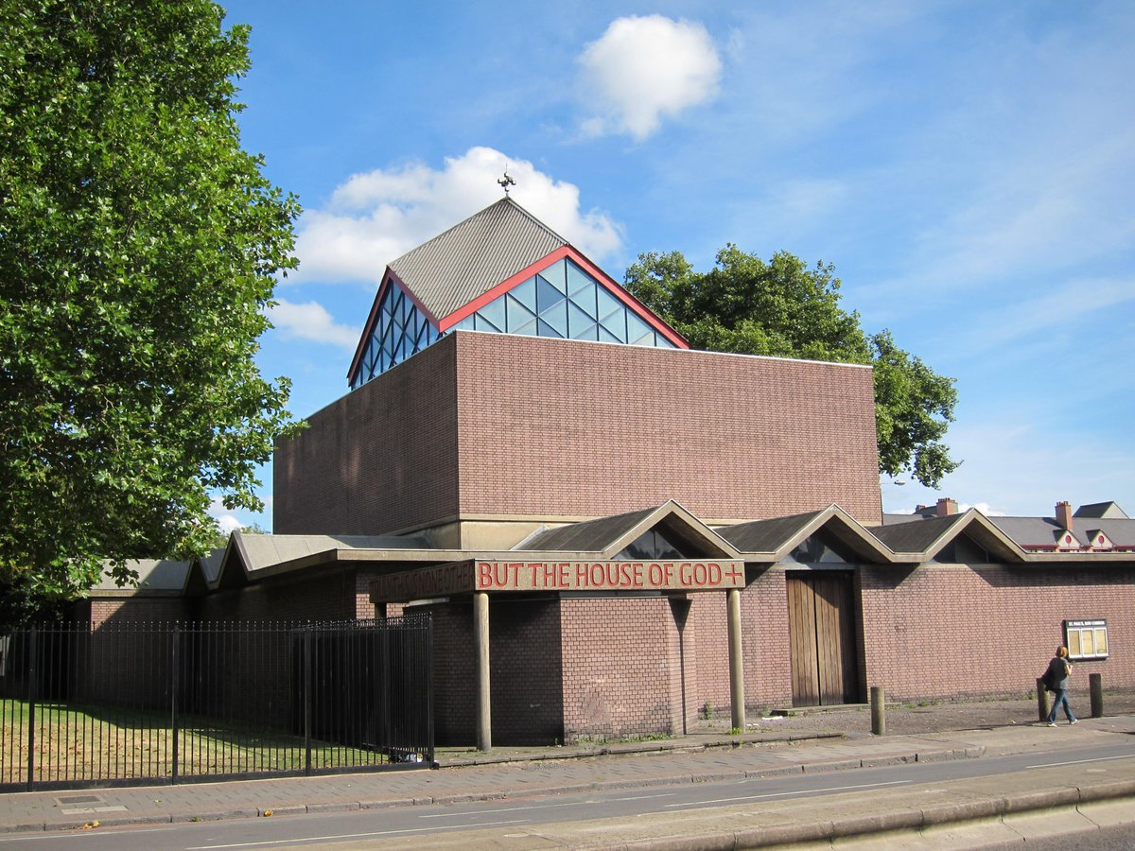
Notes:
The new St Paul’s was built in 1958 in a modern architectural [design] style. It used modern materials like concrete and an instead of colourful glass windows, has a glass ‘lantern’ to let in light through the roof.

Slide 7
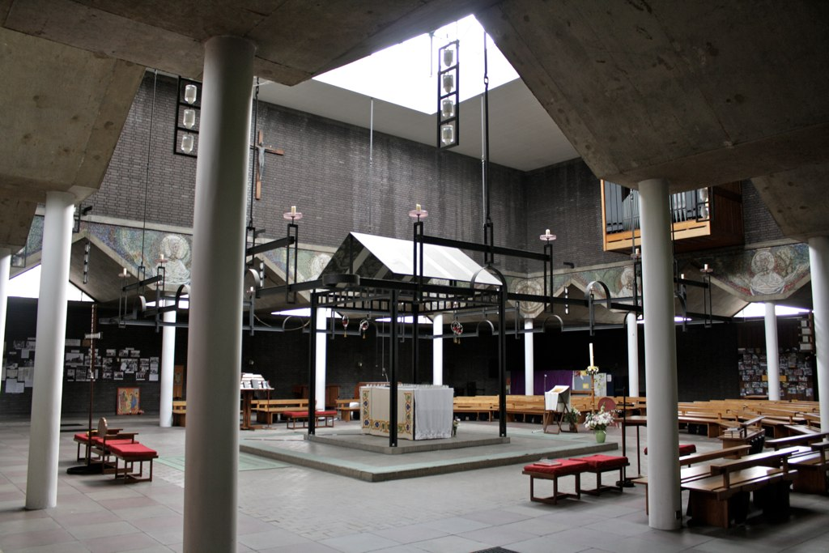
Notes:
The altar is in the centre of the church, lit by the glass lantern in the roof and the corona (ring or ‘crown’) of candles. This reflects a focus on community, and the relationships between the priest, the people, with God at the centre.

Slide 8
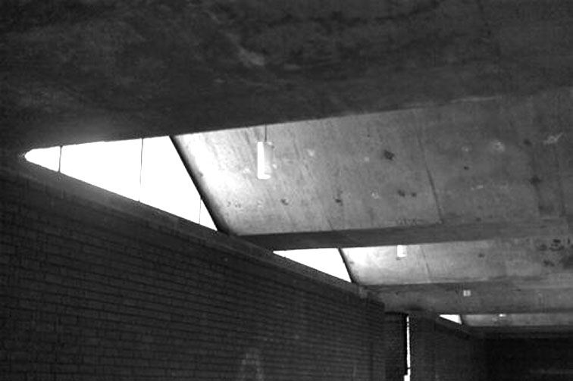
Notes:
Unlike carved, ornate, decorative style of older buildings, the style of St Paul’s church is quite simple and plain. But the designs make use of light and geometric shapes.

Slide 9
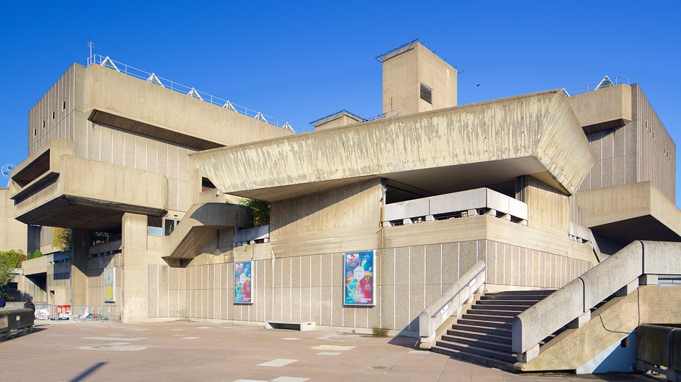
Notes:
The straight lines and undecorated surfaces of the Southbank Centre show off the building materials (raw concrete). This is like the inside of St Paul’s church. Both buildings were built after the end of World War II.

Slide 10
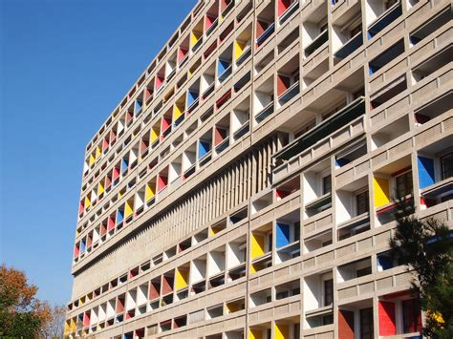
Notes:
Cité Radieuse in Marseille is a public housing complex built around the same time as St Paul’s church. Note the use of simple shapes and colour.

Slide 11
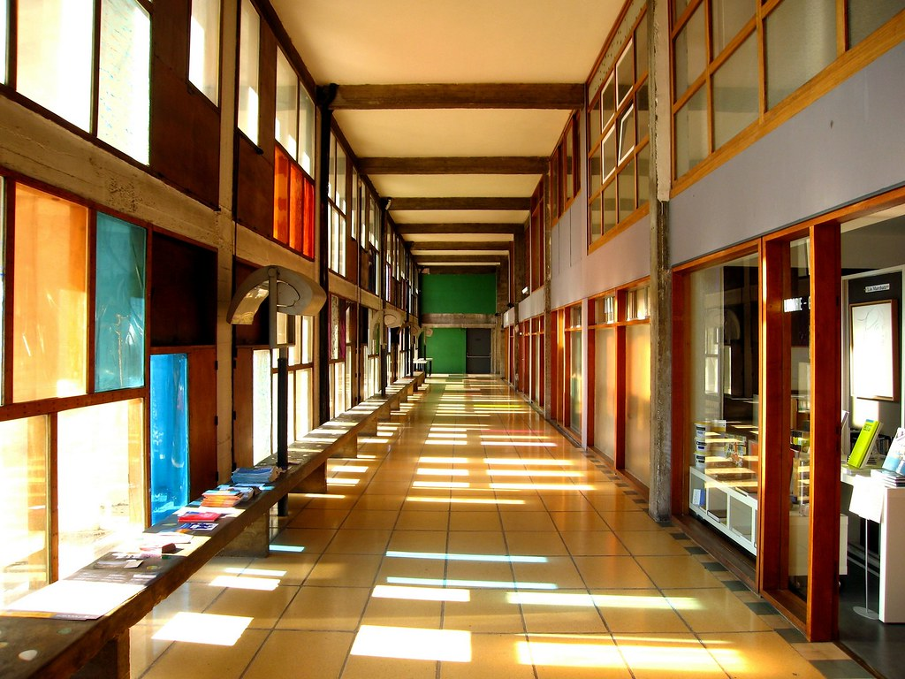
Notes:
A hallway inside Cité Radieuse using light and colour to create moods and emotions. How does it make you feel?

Slide 12
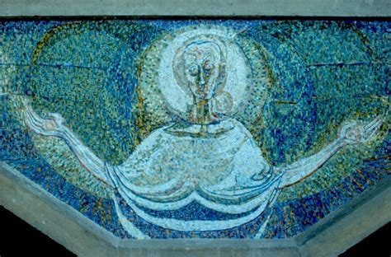
Notes:
The mosaics that decorate the walls of St Paul’s are made from brightly coloured pieces of glass.
IMAGE OK?

Slide 13
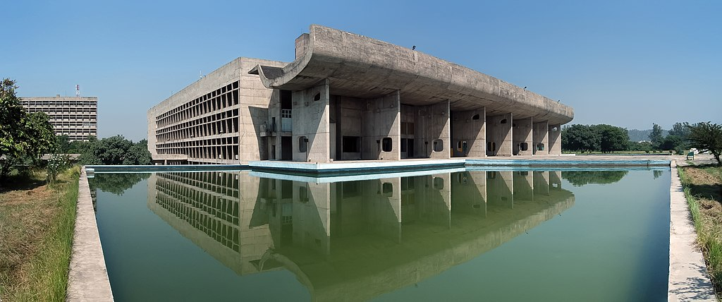
Notes:
In India the architect Le Corbusier designed a whole city, Chandigarh. This is the Palace of Assembly, a public meeting place. Look at how the design uses reflections, water, and light

Slide 14
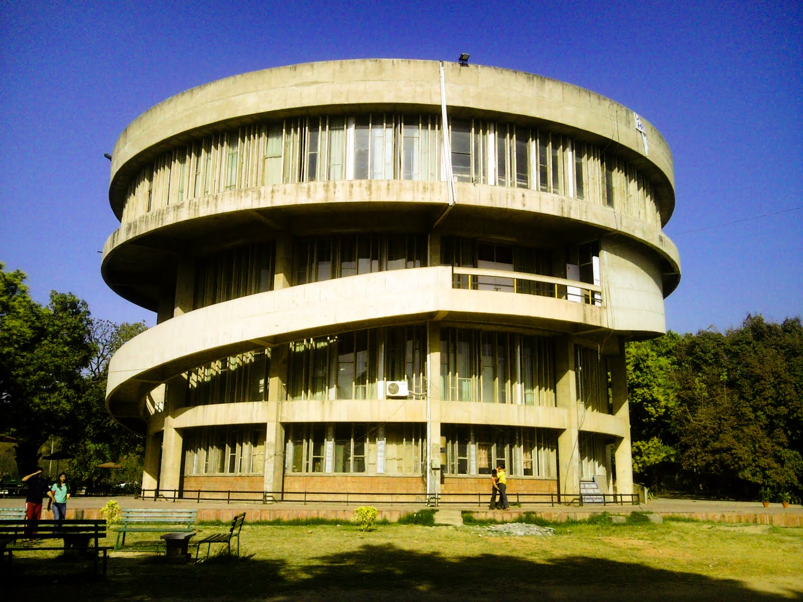
Notes:
The student building, Panjab University, Chandigarh. The shape of this building is quite unusual. How does it make you feel? Does it feel old, historical? Or modern, futuristic?

Slide 15
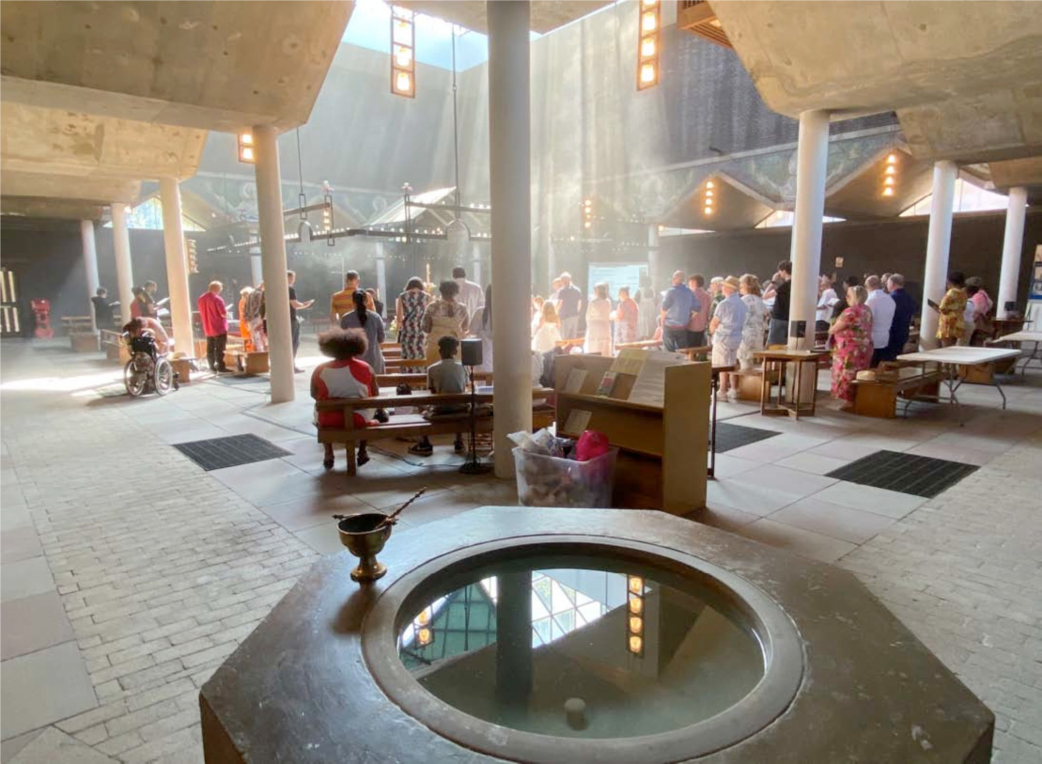
Notes:
The concrete octagonal-shaped font is made from plain concrete. It is positioned so that the water reflects the light from the central dome, symbolising the light of baptism in the Christian faith.

Slide 16
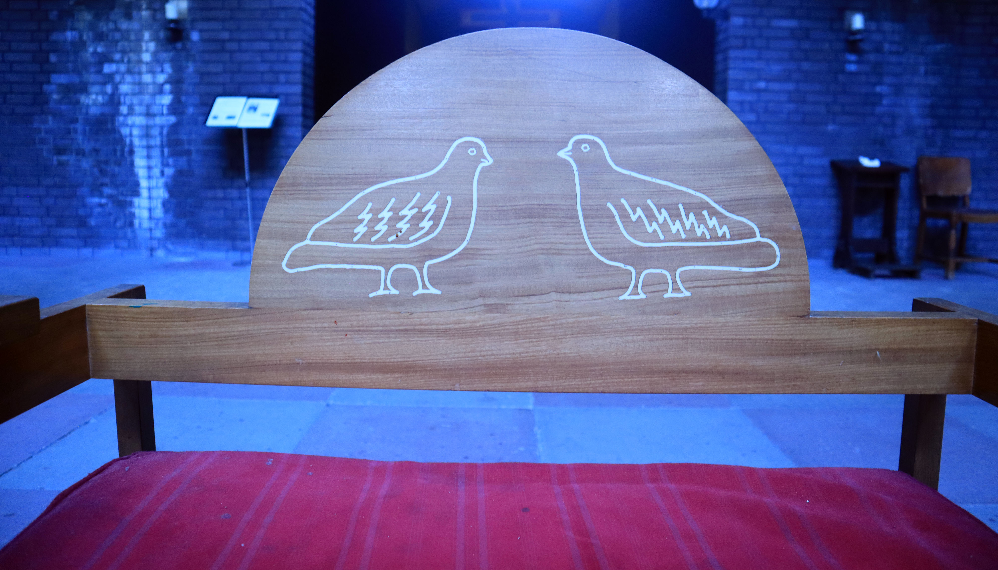
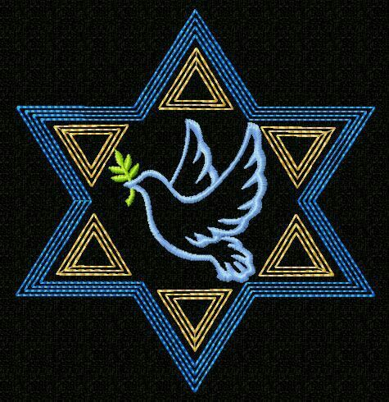
Notes:
Embroidered dove on a Jewish yarmulke (skull cap) | Carved doves in the back of the priest’s chair in St Paul’s church

Slide 17
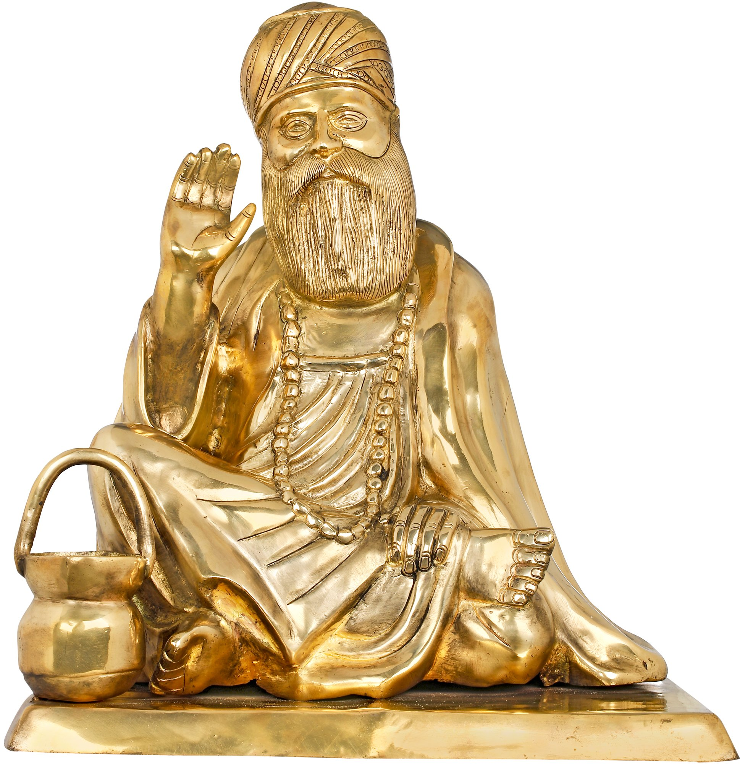
Notes:
Statue of Sikh Guru Nanak | Statue of Catholic St Faustina

Slide 18
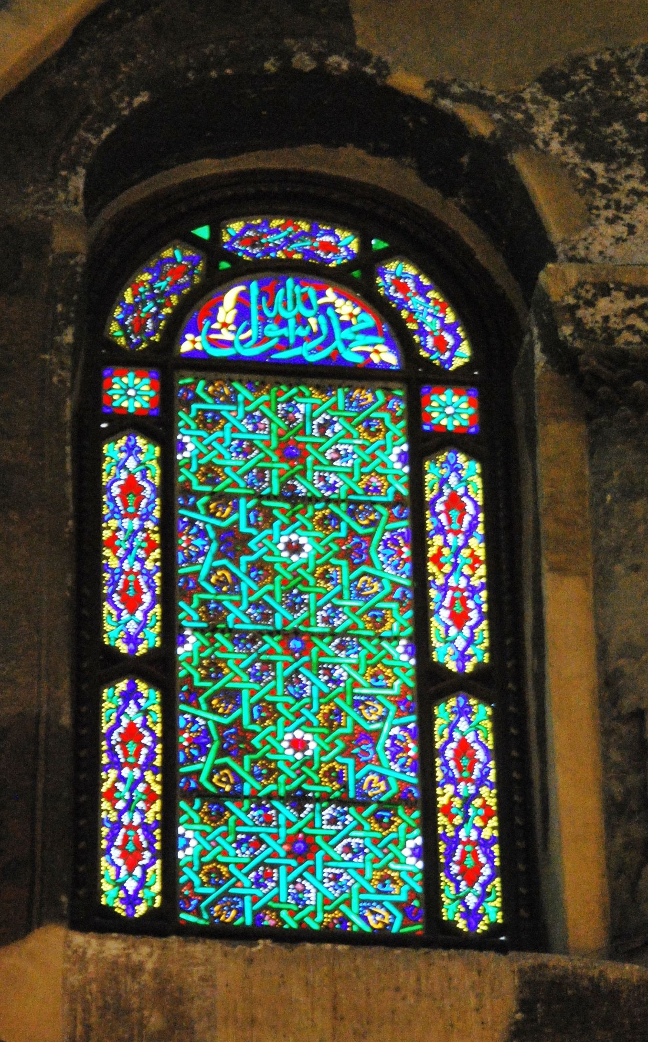
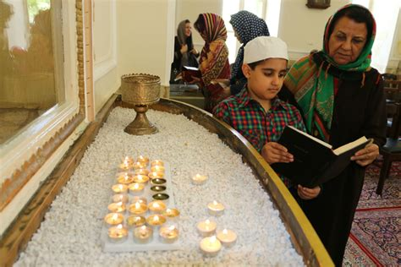
Notes:
Stained glass window from a mosque in Damascus, Syria | Worshipers lighting candles for the Zoroastrian New Year celebration

Slide 19
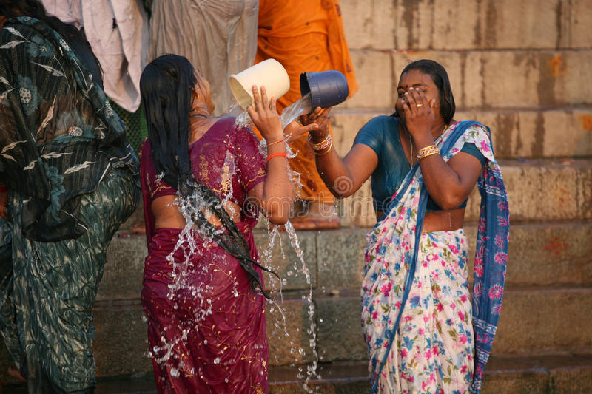
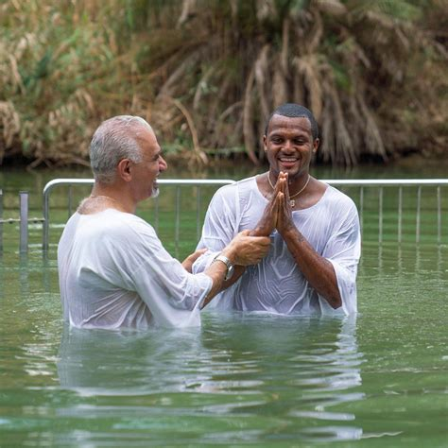
Notes:
Christian pilgrims being baptised in the River Jordan, Israel | Hindu pilgrims in the River Ganges, India

Slide 20
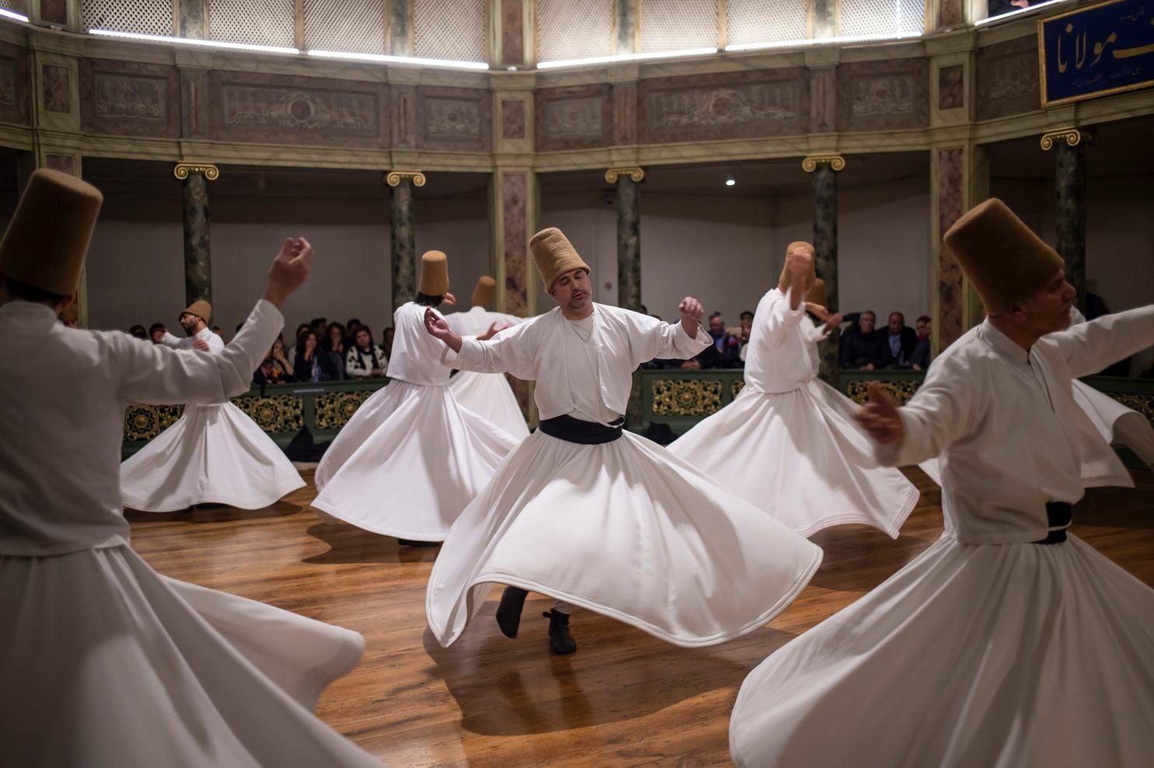
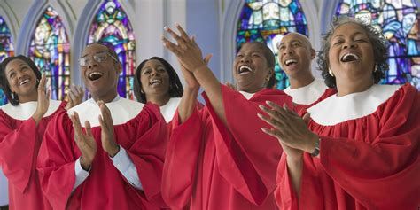
Notes:
Sufi Muslim Dervish dancing | Baptist gospel praise & worship

